Slide 1
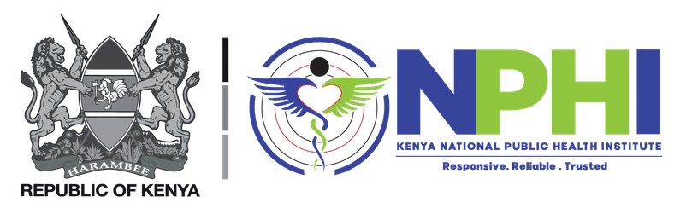

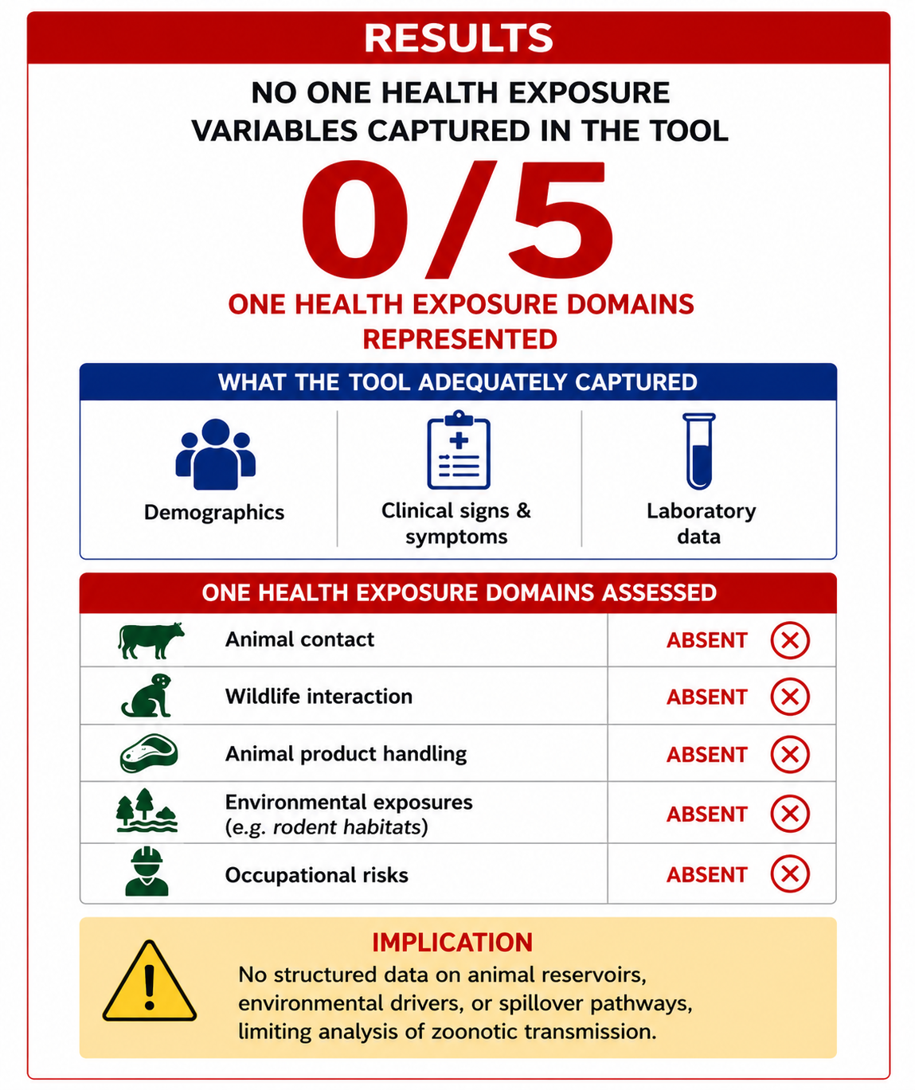
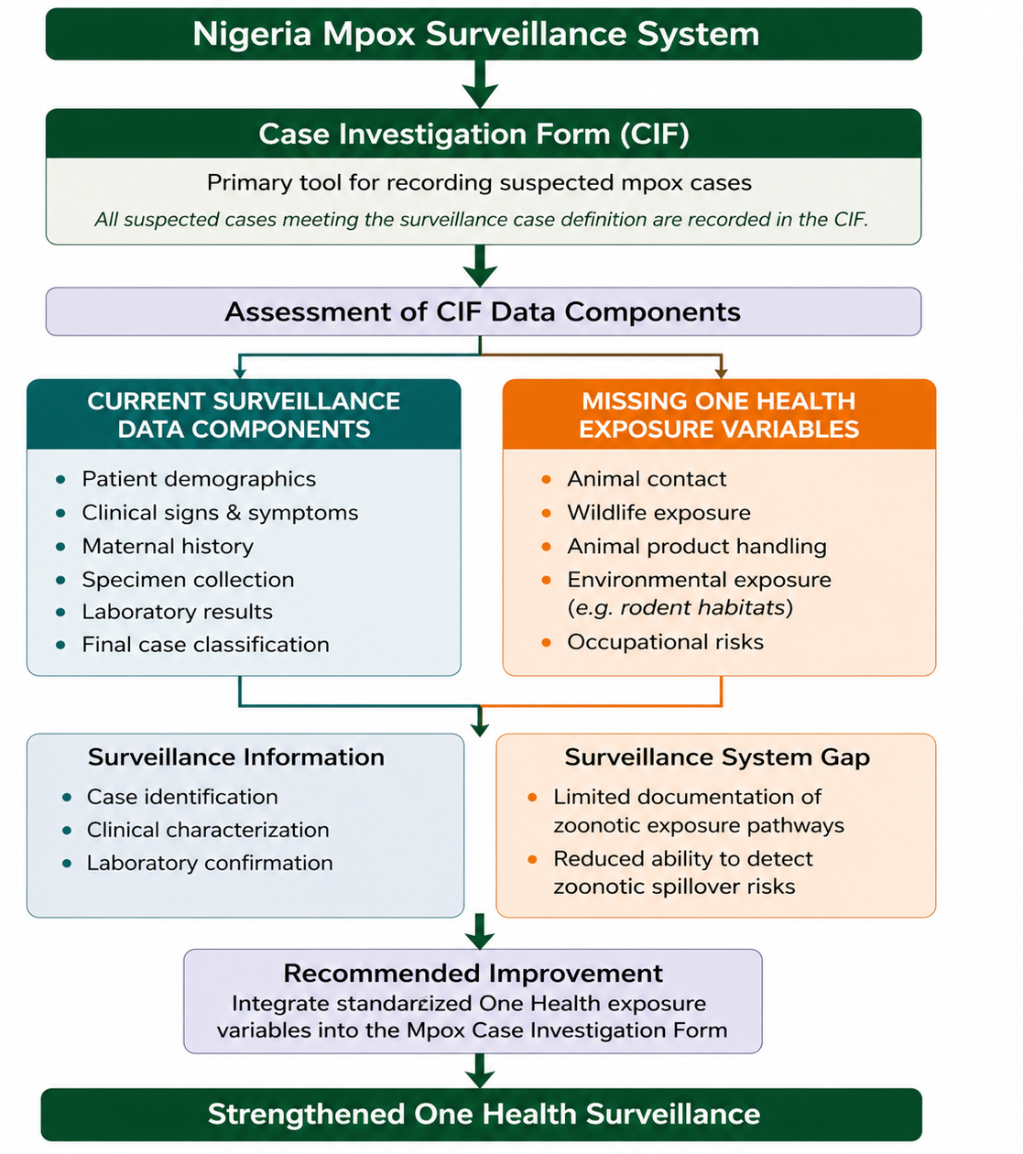

INSERT YOUR INSTITUTIONAL LOGO
FOR THE FIRST AUTHOR
Integrating One Health Exposure Data into Surveillance Systems: Evaluation of Nigeria’s Mpox Case Investigation Tool
Nsikak Inam^{1,2} , Odianosen Ehiakhamen^{1,2} Gordon Igodo^{1,2} and Osafemi Charity¹
1: Nigeria Centre for Disease Control and Prevention. 2: Nigeria Field Epidemiology and Laboratory Training Programme
BACKGROUND
Effective surveillance for zoonotic diseases depends on systematic capture of One Health (OH) exposure data.
Case investigation tools determine which exposures are documented and shape the epidemiological intelligence generated.
In Nigeria, mpox surveillance relies on a national Case Investigation Form (CIF), but its capacity to capture OH exposure variables remains unclear.
OBJECTIVE: To evaluate whether Nigeria’s mpox case investigation tool captures the One Health exposure variables required to identify zoonotic transmission pathways.
METHODOLOGY:
Study Design: Structured content analysis
Study Area: Nigeria
Data source: National mpox Case Investigation Form (CIF)
Scope: All variables across six sections of the CIF
Analysis: Variables mapped to domains, Presence/absence coding, Descriptive assessment of domain representation
RESULTS
ANALYTICAL FRAMEWORK
DISCUSSION
Surveillance systems are only as strong as the variables they capture
The absence of one health exposure data limits zoonotic risk identification, transmission pathway analysis and early detection of spillover
The current mpox surveillance system supports case confirmation, but not epidemiological intelligence for prevention.
CONCLUSIONS
The mpox CIF lacks essential One Health exposure variables
This limits detection and analysis of zoonotic transmission pathways
Integrating standardized OH variables is critical to strengthen surveillance and preparedness
POLICY & PRACTICE IMPLICATIONS
🧾 Revise the CIF to include standardized One Health exposure modules
🔗 Align surveillance tools with One Health frameworks
📊 Enable data-driven identification of zoonotic spillover risks
🤝 Strengthen integration across human, animal, and environmental health systems
📢KEY MESSAGE
What is not captured cannot be analysed:
Integrating One Health exposure data is essential for effective zoonotic surveillance.
Figure 1. Analytical framework used to assess the presence of One Health exposure variables in Nigeria’s mpox case investigation tool.
Contact: inamnsikak@gmail.com, nsikak.inam@ncdc.gov.ng

